Slide 1
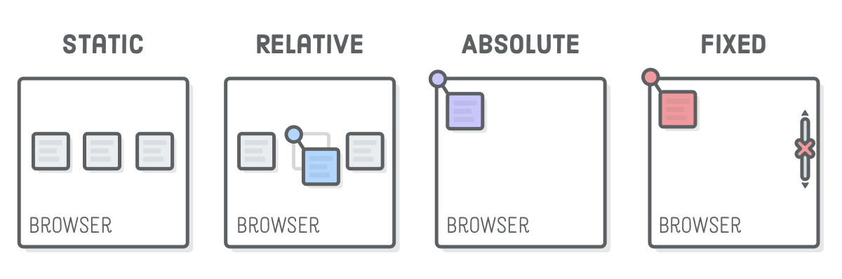
Position & Grid
CSS Positioning
SoftUni Team
Technical Trainers
Software University
https://softuni.org

Slide 2
Table of Contents
Grid Layout
Grip Properties
Position: static, relative, absolute, fixed and sticky
Positioning Properties
Z-index
Notes:
2

Slide 3
Have a Question?
sli.do
#html-css
Notes:
3

Slide 4
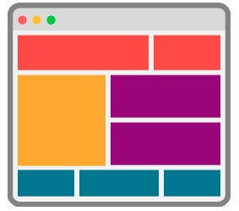
CSS Grid
Modern Layout System for the Web
Notes:
CSS grid represents a two-dimensional grid-based layout system.
Grids can be used to lay out major page areas or small UI elements.
Grid contains alignment features so we can control how the items align once placed into a grid area, and how the entire grid is aligned.

Slide 5
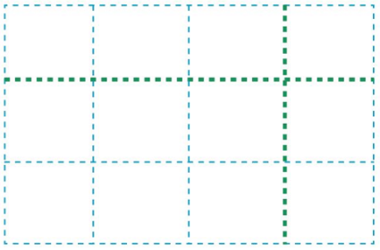
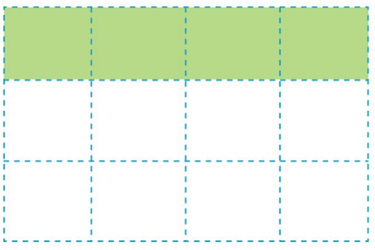
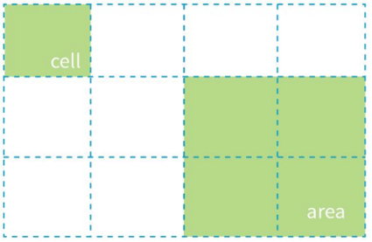
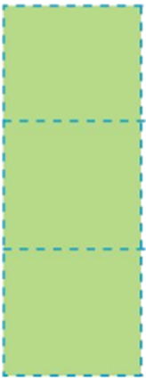
Grid Parts
The primary parts of a grid are:
Grid lines
Grid cell and grid areas
Grid tracks (rows or columns)
grid line
grid row
grid column
Notes:
Let’s go over the various parts of a CSS grid.
CSS grid comprises of lines, cells, areas and tracks.
We’ll start with grid lines. They are the dividing lines that make up the structure of the grid. They can be vertical and horizontal and are located on either side of a row or column.
A grid cell represents the smallest unit on a grid. We can think of it as a table cell. Once a grid is defined as a parent, the child items will lay themselves out in one cell each of the defined grid.
A grid area should be rectangular, and its items can span one or more cells both by row or by column.
We define rows and columns on our grid with the grid-template-columns and grid-template-rows properties. These define the grid tracks.
A grid tack is the space between any two lines on the grid.

Slide 6
Grid Container
An HTML element becomes a grid container when its display property is set to grid or inline-grid
.grid-container {
display: grid;
}
.grid-container {
display: inline-grid;
}
Notes:
We can create a grid container by declaring “display: grid” or “display: inline-grid” on an element.
After we have done this, all of the direct child elements will become grid elements.
The grid container wraps all of the grid items.

Slide 7
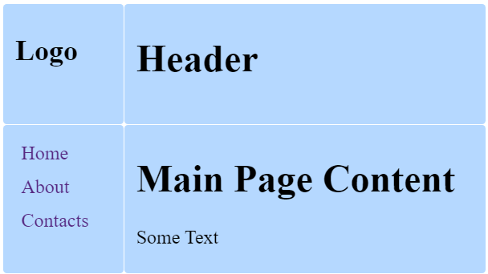
Grid Template
Grid templates define the look of the grid: count of the rows and columns and their size
body {
display: grid;
grid-template-rows: 100px 400px;
grid-template-columns: 100px auto;
}
100px
auto
This example will create:
Two rows with sizes: 100px and 400px
Two columns with sizes: 100px and auto size
100px
400px
Notes:
Grid templates define the columns and rows of the grid with a space separated list of values.
The values represent the track size, and the space between them represents the grid line.
**Example in IDE**

Slide 8
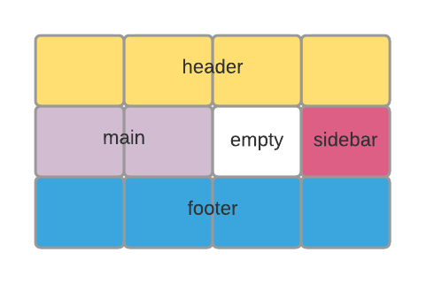
Grid Area and Grid Template Area
Grid area is a rectangular area made up of one or more adjacent grid cells
Defining grid areas in CSS:
Referencing the grid areas:
header { grid-area: header; }
body { grid-template-areas:
"header header header header"
"main main empty sidebar"
"footer footer footer footer";
https://developer.mozilla.org/en-US/docs/Web/CSS/grid-template
Notes:
As we previously stated, grid areas are rectangular, and they are made up of several grid cells.
A grid area can be composed of any number of grid cells.
Let us see how we can define a grid area in CSS.
With the property “grid-area” we can define the area’s name and we can use it as a reference with the “grid-template-areas” property.
DEMO

Slide 9
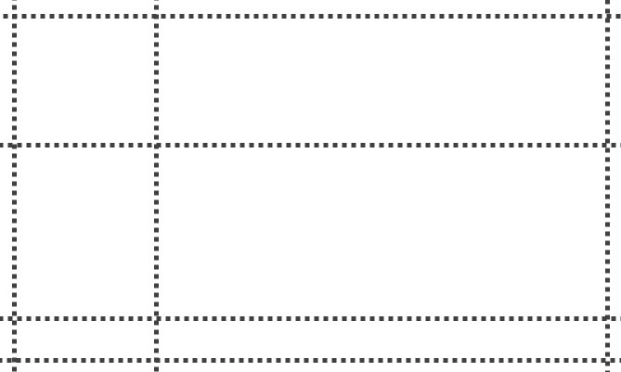
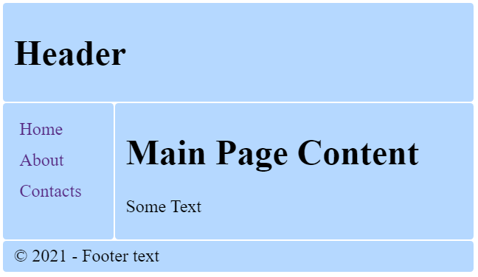
Grid Area – Examples
body { display: grid;
grid-template-areas:
"header header"
"aside main"
"footer footer";
grid-template-columns: 100px auto;
}
header { grid-area: header; }
aside { grid-area: aside; }
main { grid-area: main; }
footer { grid-area: footer; }
Notes:
IDE DEMO

Slide 10
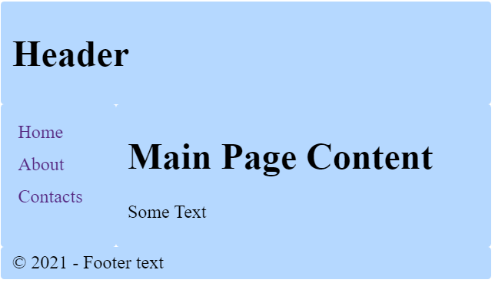
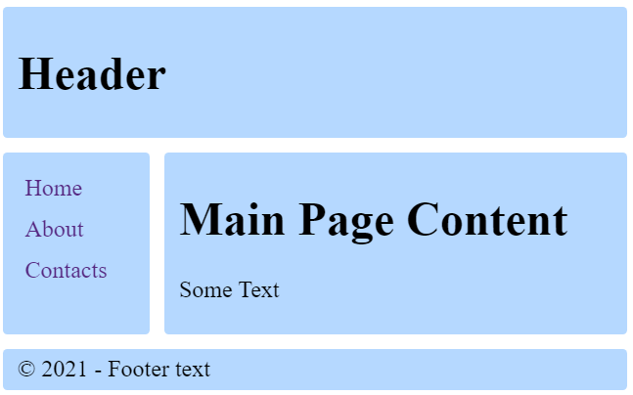
Gap
Gap between each cell horizontally and vertically
https://developer.mozilla.org/en-US/docs/Web/CSS/gap
body {
display: grid;
grid-template-columns:
100px auto;
gap: 10px;
grid-template-areas:
"header header"
"aside main"
"footer footer";
}
gap: 10px;
Notes:
The grid gaps represent the space between each grid item.
The gap property sets the gap between rows and columns.
DEMO

Slide 11
repeat()
repeat() notation helps you repeat part of code
Equal to
.body {display: grid;
grid-template-rows: 200px 100px;
grid-template-columns: repeat(4, 100px);
}
. body {display: grid;
grid-template-rows:200px 100px;
grid-template-columns: 100px 100px 100px 100px;
}
Notes:
Now let’s go over the repeat notation. With it we can repeat grid tracks and it’s very useful for grid items with equal sizes.
The repeat function accepts 2 arguments – the first represents the number of times the defined tracks should repeat, and the second is the track definition.
DEMO

Slide 12
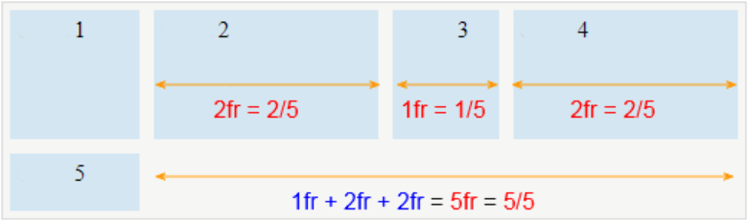
FR (Fraction)
FR (Fraction) is a unit in the CSS grid system.
You can use it to take advantage of the available space.
.container {display: grid;
grid-template-rows:100px 50px;
grid-template-columns: 100px 2fr 1fr 2fr;
}
Notes:
“FR” is a fractional length unit. 1”fr” represents 1 part of the available space.
We can mix “fr” values with fixed and percentage values.
DEMO

Slide 13
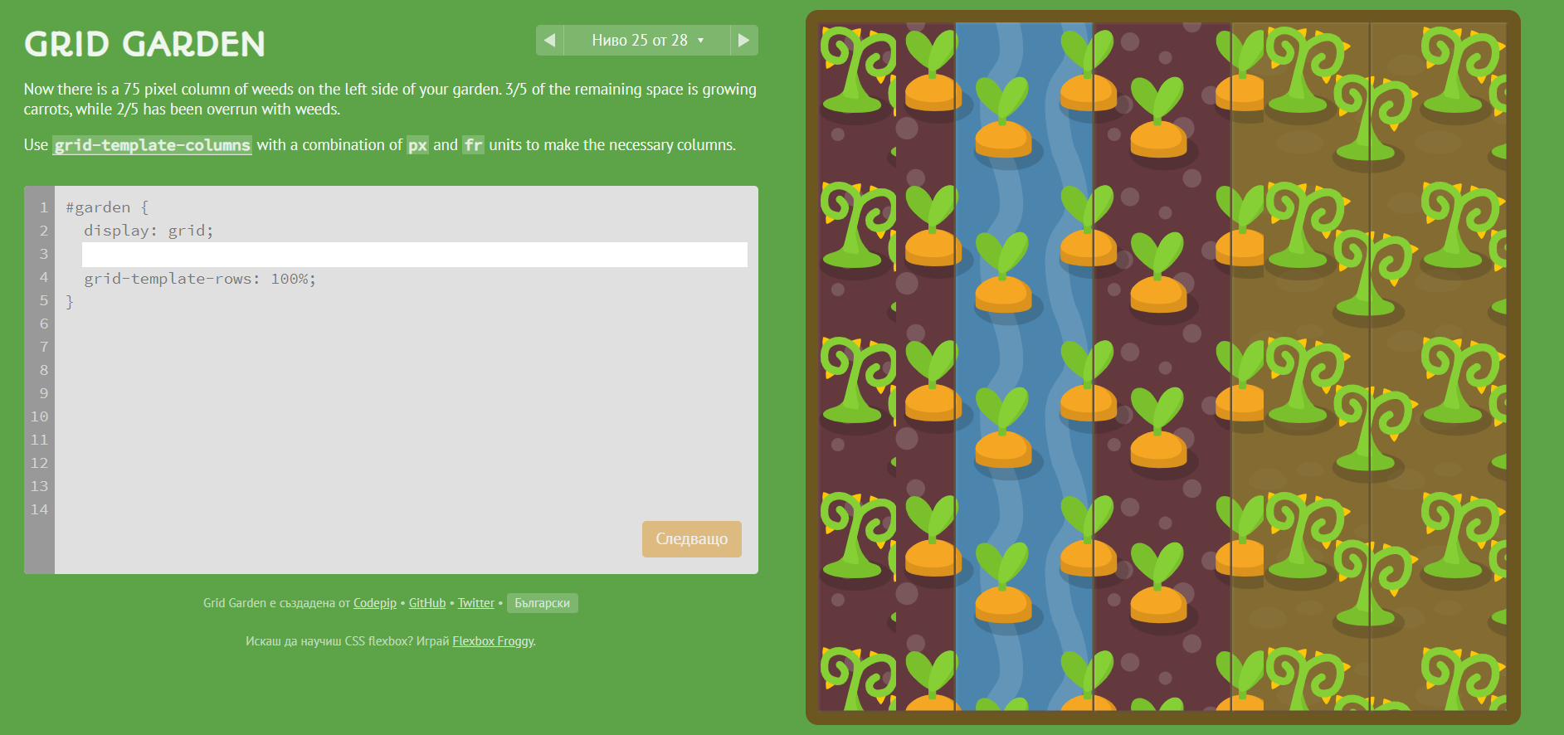
Play and Learn
https://cssgridgarden.com/#bg

Slide 14
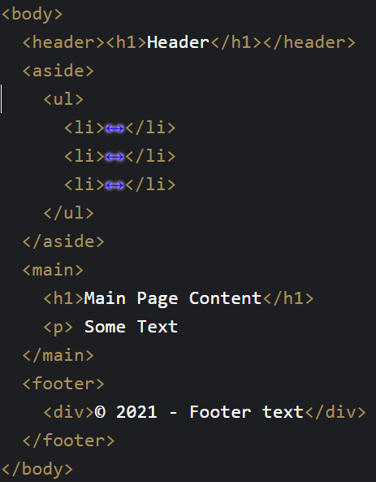
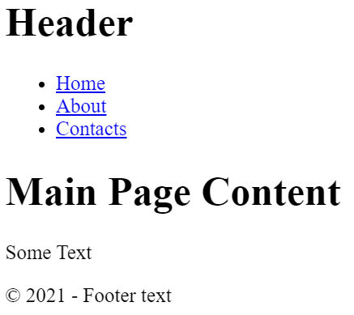
CSS Grid – Example
Notes:
IDE DEMO

Slide 15
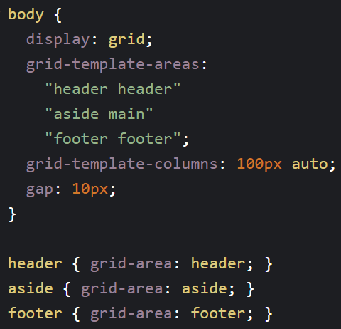
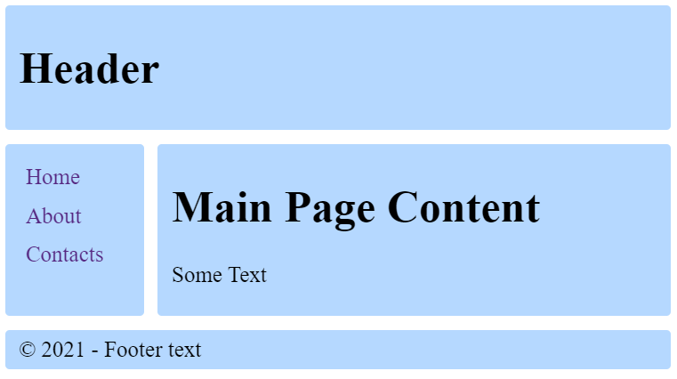
CSS Grid – Example
Notes:
IDE DEMO

Slide 16
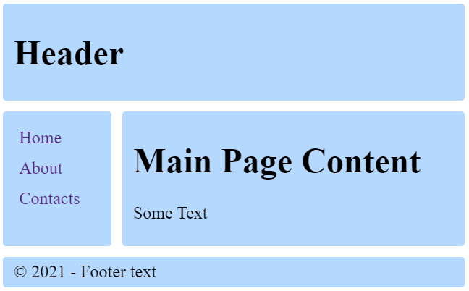
Demo: CSS Grid Site Layout
https://codepen.io/snakov/pen/jOVJXVN

Slide 17
Specifies the Type of Positioning Method Used for an Element

Slide 18

Position
Position properties:
static
relative
absolute
fixed
sticky

Slide 19
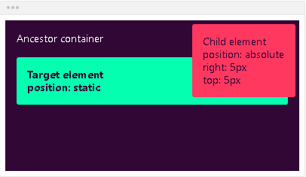
Position Static
Static - the default state of every element
Puts the element into its normal position in the document layout flow
It will NOT react to the following properties: top, bottom, left, right, z-index
div {
position: static;
}

Slide 20
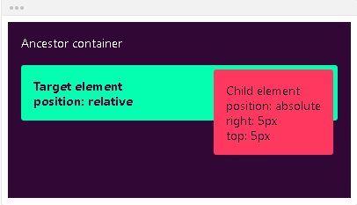
Position Relative
It looks like static positioning, but once the positioned element has taken its place, you can then modify its final position with the positional properties
div {
position: relative;
}

Slide 21
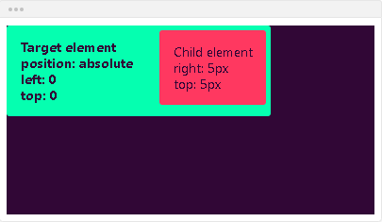
Position Absolute
Absolute - the element will NOT remain in the natural flow of the page
Reacts to the positional properties
It will positon itself according to the closest positioned ancestor
div {
position: absolute;
}

Slide 22
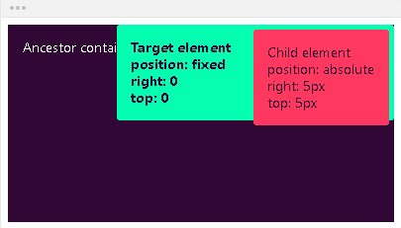
Position Fixed
Fixed - the element will NOT remain in the natural flow of the page
Reacts to the positional properties
Positions itself according to the viewport
div {
position: fixed;
}

Slide 23
Position Sticky
The element is positioned based on the user's scroll position
A sticky element switches between relative and fixed, depending on the scroll position
It is positioned relative until a given offset position is met in the viewport - then it ''sticks'' in place (like position: fixed)

Slide 24
Position Sticky – Example
.main-container {
max-width: 600px;
margin: 0 auto;
border: 10px solid green;
padding:10px;
margin-top:40px;
} .main-header,
.main-content,
.main-footer {
padding: 10px;
background: #aaa;
border: 5px dashed #000;
margin: 20px 0;
}
<main class="main-container">
<header class="main-header">
HEADER
</header>
<div class="main-content">
MAIN CONTENT
</div>
<footer class="main-footer">
FOOTER
</footer>
</main>

Slide 25
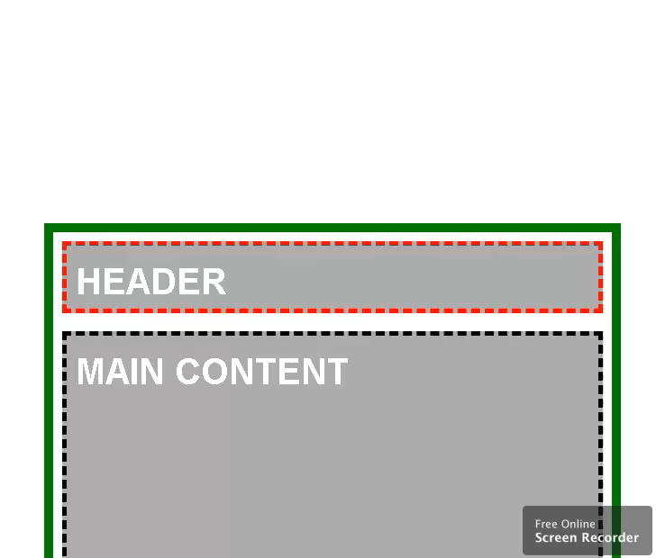
Position Sticky – Example
.main-content {
min-height: 1000px;
}
.main-header {
height: 50px;
border-color: red;
position: sticky;
top: 0;
}

Slide 26
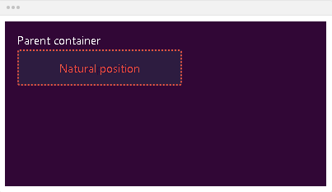
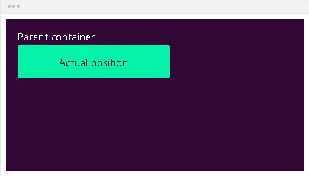
Bottom
Bottom - defines the position of the element according to its bottom edge
bottom: auto; - the element will remain in its natural position

Slide 27
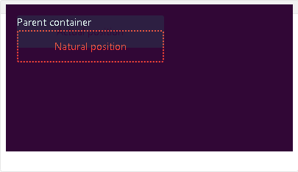
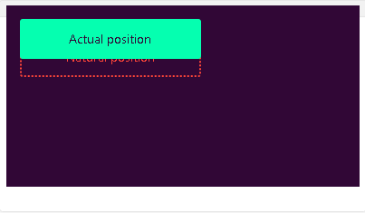
Bottom
If the element is in position relative, the element will move upwards by the amount defined by the bottom value
bottom: 20px;

Slide 28
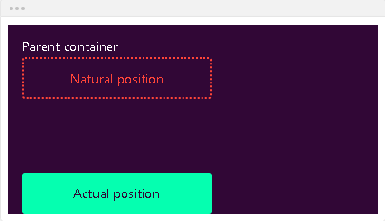
Bottom
If the element is in position absolute, the element will position itself from the bottom of the first positioned ancestor
bottom: 0;

Slide 29
Left
Defines the position of the element according to its left edge
left: auto; - the element will remain in its natural position

Slide 30
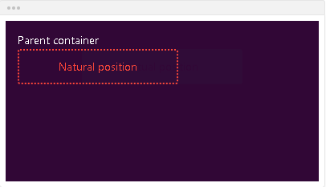
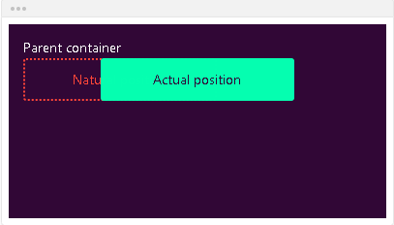
Left
left: 80px; - if the element is in position relative, the element will move left by the amount defined by the left value

Slide 31
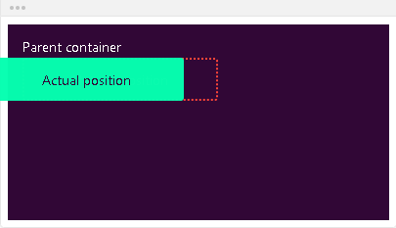
Left
left: -20px; - if the element is in position absolute, the element will position itself from the left of the first positioned ancestor

Slide 32
Right
Right - defines the position of the element according to its right edge
right: auto; - the element will remain in its natural position
right: 80px; - if the element is in position relative, the element will move right by the amount defined by the right value
right: -20px; - if the element is in position absolute, the element will position itself from the right of the first positioned ancestor

Slide 33
Top
Top - defines the position of the element according to its top edge
top: auto; - the element will remain in its natural position
top: 20px; - if the element is in position relative, the element will move downwards by the amount defined by the top value
top: 0; - if the element is in position absolute, the element will position itself from the top of the first positioned ancestor

Slide 34
Center
Center - defines the position of the element according to center of the window
position: absolute;- it will position the element relative to its first positioned parent element
If it can’t find one, it will be relative to the document
top: 50%; left: 50%; - the element will step out from the top left corner
These properties are set on the child element

Slide 35
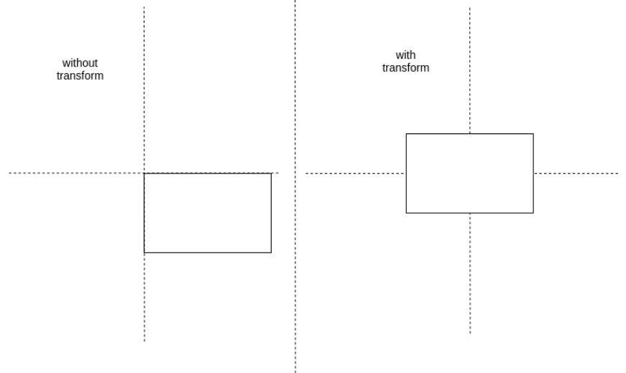
Center
transform: translate(-50%, -50%); - it will pull back the item with its half width and height
.parent { position: relative; } .child { position: absolute; top: 50%; left: 50%; transform: translate( -50%, -50%); }

Slide 36
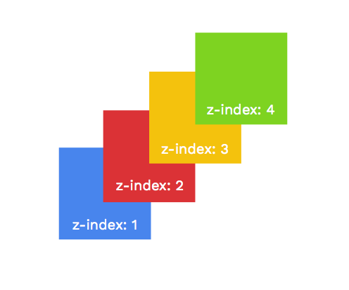
Specifies the Stack order of an Element

Slide 37
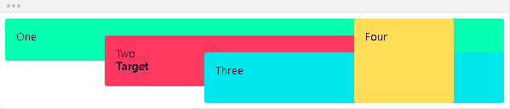
Z-index
Defines the order of the elements on the z-axis. It only works on positioned elements (anything apart from static)
Default value: z-index: auto;
The order is defined by the order in the HTML code:

Slide 38
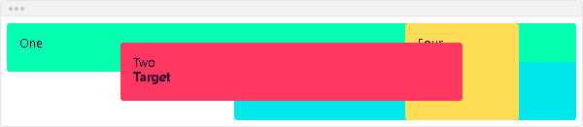
Z-index
The z-index value is relative to the other ones
The target element is move in front of its siblings
z-index: 1;

Slide 39
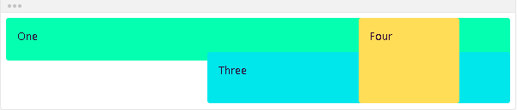
Z-index
You can use negative values
The target element is moved behind its siblings
z-index: -1;

Slide 40

Summary
Grid Layout
Grid Properties
Properties for the Parent (Grid Container)
Properties for the Children (Grid Items)
Positioning properties
Z-Index
Notes:
40

Slide 41
Questions?
Notes:
41

Slide 42










SoftUni Diamond Partners

Slide 43



Educational Partners

Slide 44

License
This course (slides, examples, demos, exercises, homework, documents, videos and other assets) is copyrighted content
Unauthorized copy, reproduction or use is illegal
© SoftUni – https://about.softuni.bg/
© Software University – https://softuni.bg
Notes:
44

Slide 45
Trainings @ Software University (SoftUni)
Software University – High-Quality Education, Profession and Job for Software Developers
softuni.bg, about.softuni.bg
Software University Foundation
softuni.foundation
Software University @ Facebook
facebook.com/SoftwareUniversity
Software University Forums
forum.softuni.bg
45
Notes:
45

